Slide 1
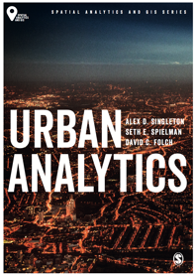
ABM and Cities
Alex D. Singleton, Seth E. Spielman, David C. Folch (2017) Urban Analytics. London: Sage.

Slide 2
Learning Objectives
Differences between aggregate and disaggregate modeling frameworks.
The main features of cellular automata, microsimulation, and agent-based modeling.
What agents are, and how they function within an agent-based model.
Those features of a complex system.
Constraints on the operational use of agent-based models.

Slide 3
Cities as Interacting Parts
Possible to consider cities as collections of interacting entities
When cities are studied at an aggregate level it is often difficult to observe outcomes that may emerge through a collective of individual-level behaviors
Popularity of aggregate modeling
Historically limited availability of disaggregate data
Often easier to implement aggregate modeling
For applications that require empirical specification or evaluation, urban data are more prevalently available at an aggregated rather than individual scale

Slide 4
Cities as Interacting Parts
Problems with aggregate models
Can be constraining when an objective of the analysis relates to the examination of individual behaviors
Specifically when these are concerned with interactivity or non-linear dynamics
Three of the main methodological frameworks
Cellular automata
Spatial microsimulation
Agent-based modeling.

Slide 5
Schelling Model
Thomas Schelling – US Economist (1921–2016)
The motivations of individuals can create aggregate level outcomes that are at odds with what individuals want
e.g - If individuals prefer to live in a neighborhood that is 51% the same race
a fairly integrated neighborhood
The cumulative results of individuals seeking such a neighborhood composition is that almost total segregation emerges
The individual motives (for integration) would not have been observable from the aggregate (segregated) landscape
Schelling first developed this idea as simple checkers like game, but it was subsequently converted into computer models

Slide 6
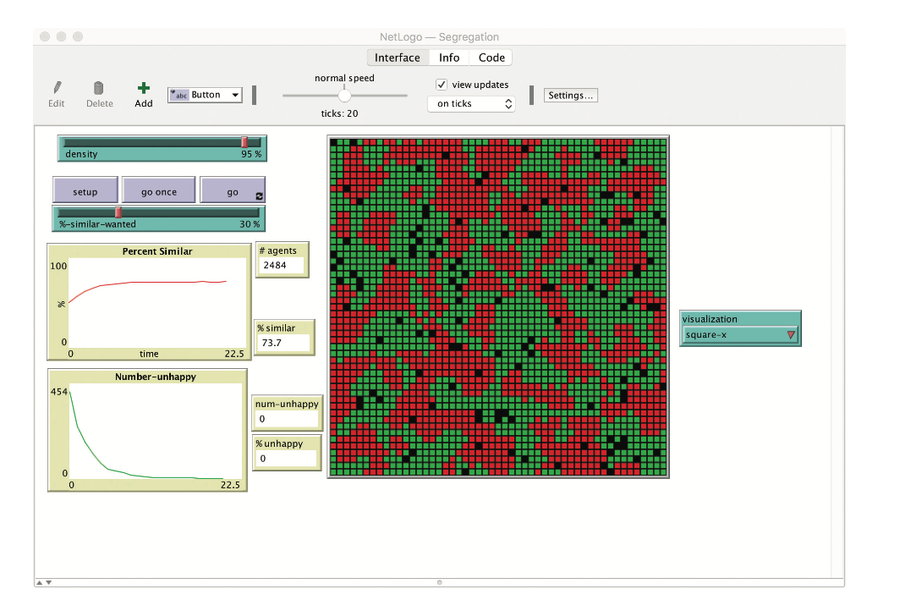
Schelling Model
A NetLogo implementation of the Schelling model
Source: Wilensky, U. (1999). NetLogo. http://ccl.northwestern.edu/netlogo/. Center for Connected Learning and Computer-Based Modeling, Northwestern University, Evanston, IL.

Slide 7
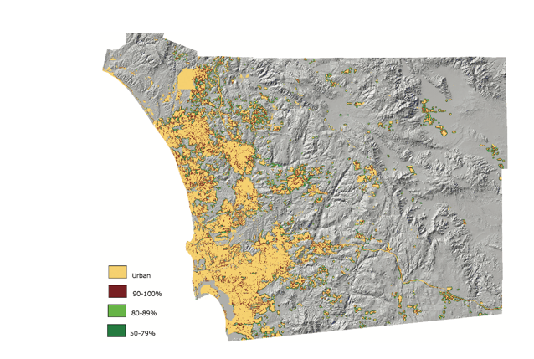
Cellular automata
Defined as a grid of cells (like a checker board), each cell is called an “automata”.
Each automata stores a numeric value.
As a model runs through a series of time steps, each automata can change their assigned value (state) based on a set of rules which takes into consideration those values in the surrounding cells (neighborhood).
A SLEUTH model for San Diego in 2030 showing predicted levels of urbanization Source: Keith Clarke, UCSB, USA. Reprinted with permission

Slide 8
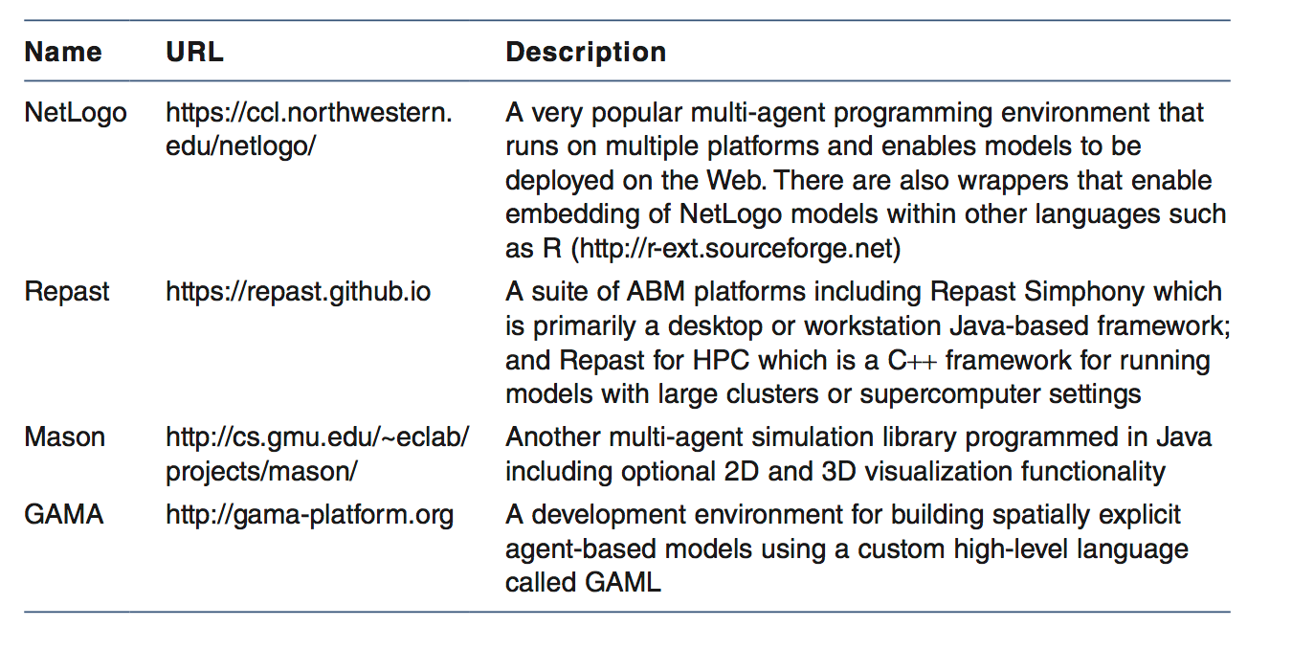
Agent-Based Models
Agent-based modeling (ABM) is a collective term for a software simulation technique that enables interactivity between individual entities
Some popular open source ABM frameworks

Slide 9
Agent-Based Models
Typically initiated with a simple set of rules that are specified at a micro level (e.g., individuals)
derived from theory/empirical observation
Rule sets govern how each agent interacts with the other agents within the simulation and their environment
Over the course of a simulation the macro-level outcomes emerge as a result of a complex of individual-level adaptive behavior, including various types of non-linear dynamics
referred to as emergence

Slide 10
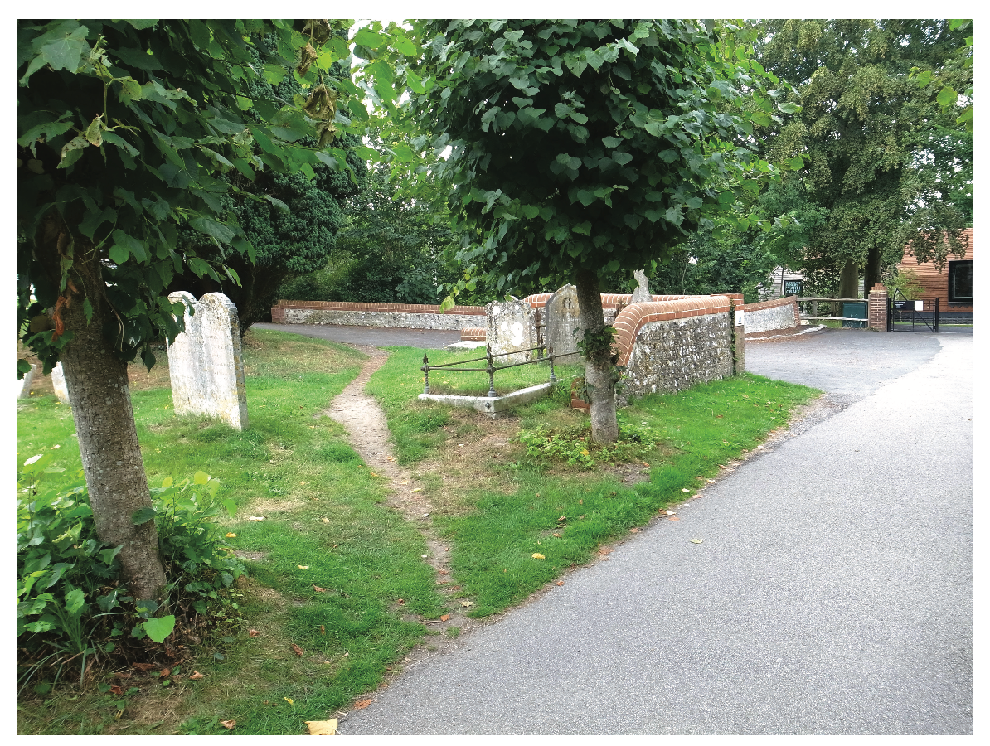
Desire paths as an example of an emergent feature Source: Photograph by George Redgrave CC BY-ND 2.0 (Flickr)

Slide 11
Complex Systems
Multiple equilibrium
Models may have a number of steady states that are maintained under quite different parameter settings.
Non-stationary
Stochastic outputs that change after each run.
Self-organization
Various dynamic behaviors ranging from chaotic to regular oscillations between different steady states.
Phase transitions
May occur between different steady states.

Slide 12
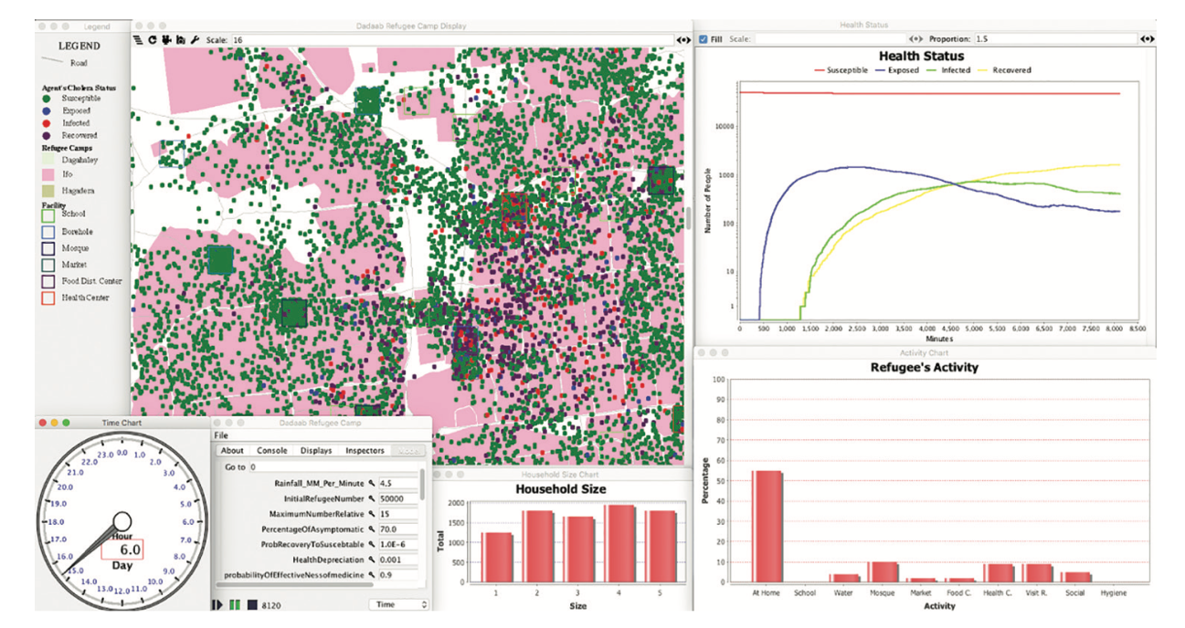
Agent-Based Models: Example
A MASON graphical user interface showing a cholera disease agent-based model of the Dadaab refugee camp in Kenya
Source: Crooks and Hailegiorgis (2014). Reproduced with permission

Slide 13
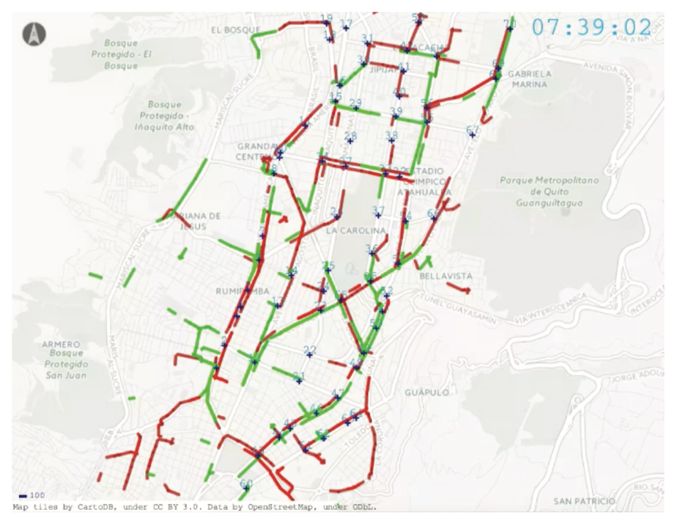
Agent-Based Models: Example
Graphical output showing different traffic volumes Source: www.matsim.org/scenario/quito-ecuador. Reproduced with permission

Slide 14
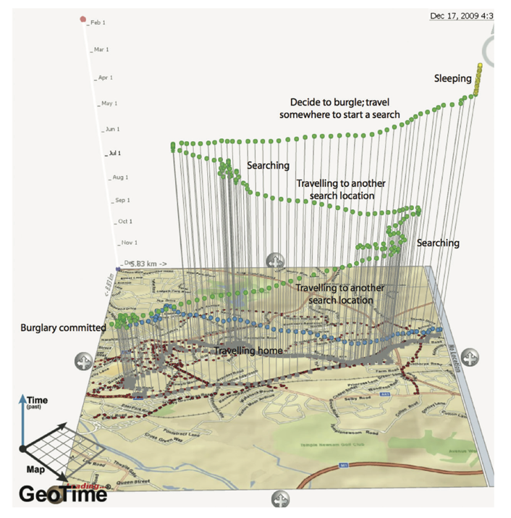
Agent-Based Models: Example
An agent-based model considering burglary
Source: Malleson (2010). Reprinted with permission

Slide 15
Conclusions
Disaggregate modeling has a particular use case over aggregate models
Useful for the exploration of complex systems
Various modeling frameworks / approaches; multiple software implementations

